Slide 1
CANS: Construction Alert Notification System
A solution to road construction delays
Presented by
Brian Raimondo Kehan Wang Manny Dhesi Accardo Cheng
Notes:
Hello everyone, thank you for coming to the presentation on our project: a Construction Alert Notification System, aka CANS, which we believe can be a solution to the road construction delays.

Slide 2
Project Overview
Aim to design the interface for a website with notification alert system that can relay road construction information to users in advance.
The website allows users to create an account and sign in, as well as input self information such as daily routes and departure/arrival time frame.
Users are able to choose their preferred method of notification, such as Email or text message.
Alert messages on road construction will be sent to users, customized by matching their inputs with data from official sites.
The messages cover both ongoing and future projects, provide details such as location, date and level of road closure.
Notes:
Our project aims to design the interface for a website that delivers personalized road construction info to users in advance. The system allows users to create accounts, input their daily routines and select notification methods. It then sends out customized alerts on both ongoing and planned construction projects from official data source, including the locations, dates, and severity of impact. We believe a system like this can help people avoid unexpected delays and better plan their commutes.

Slide 3
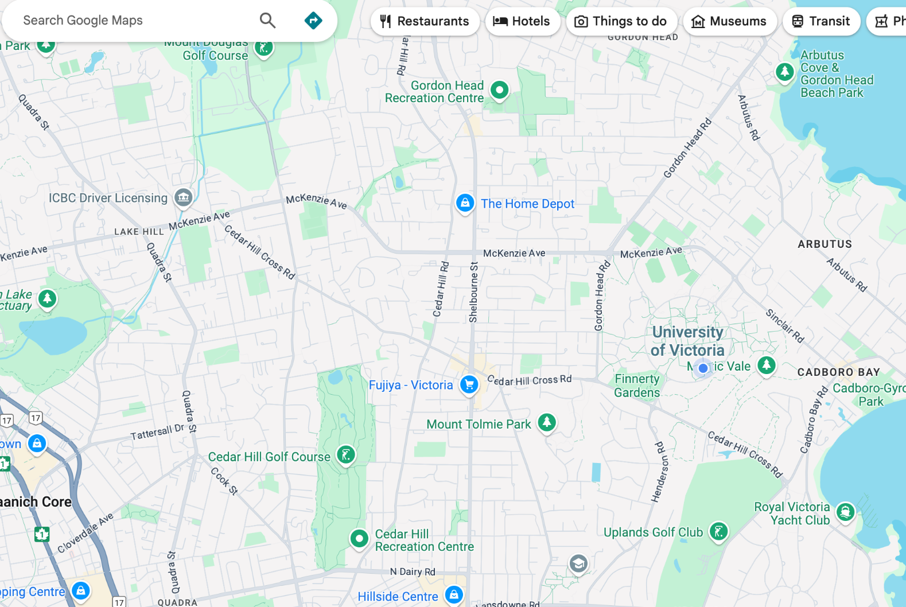
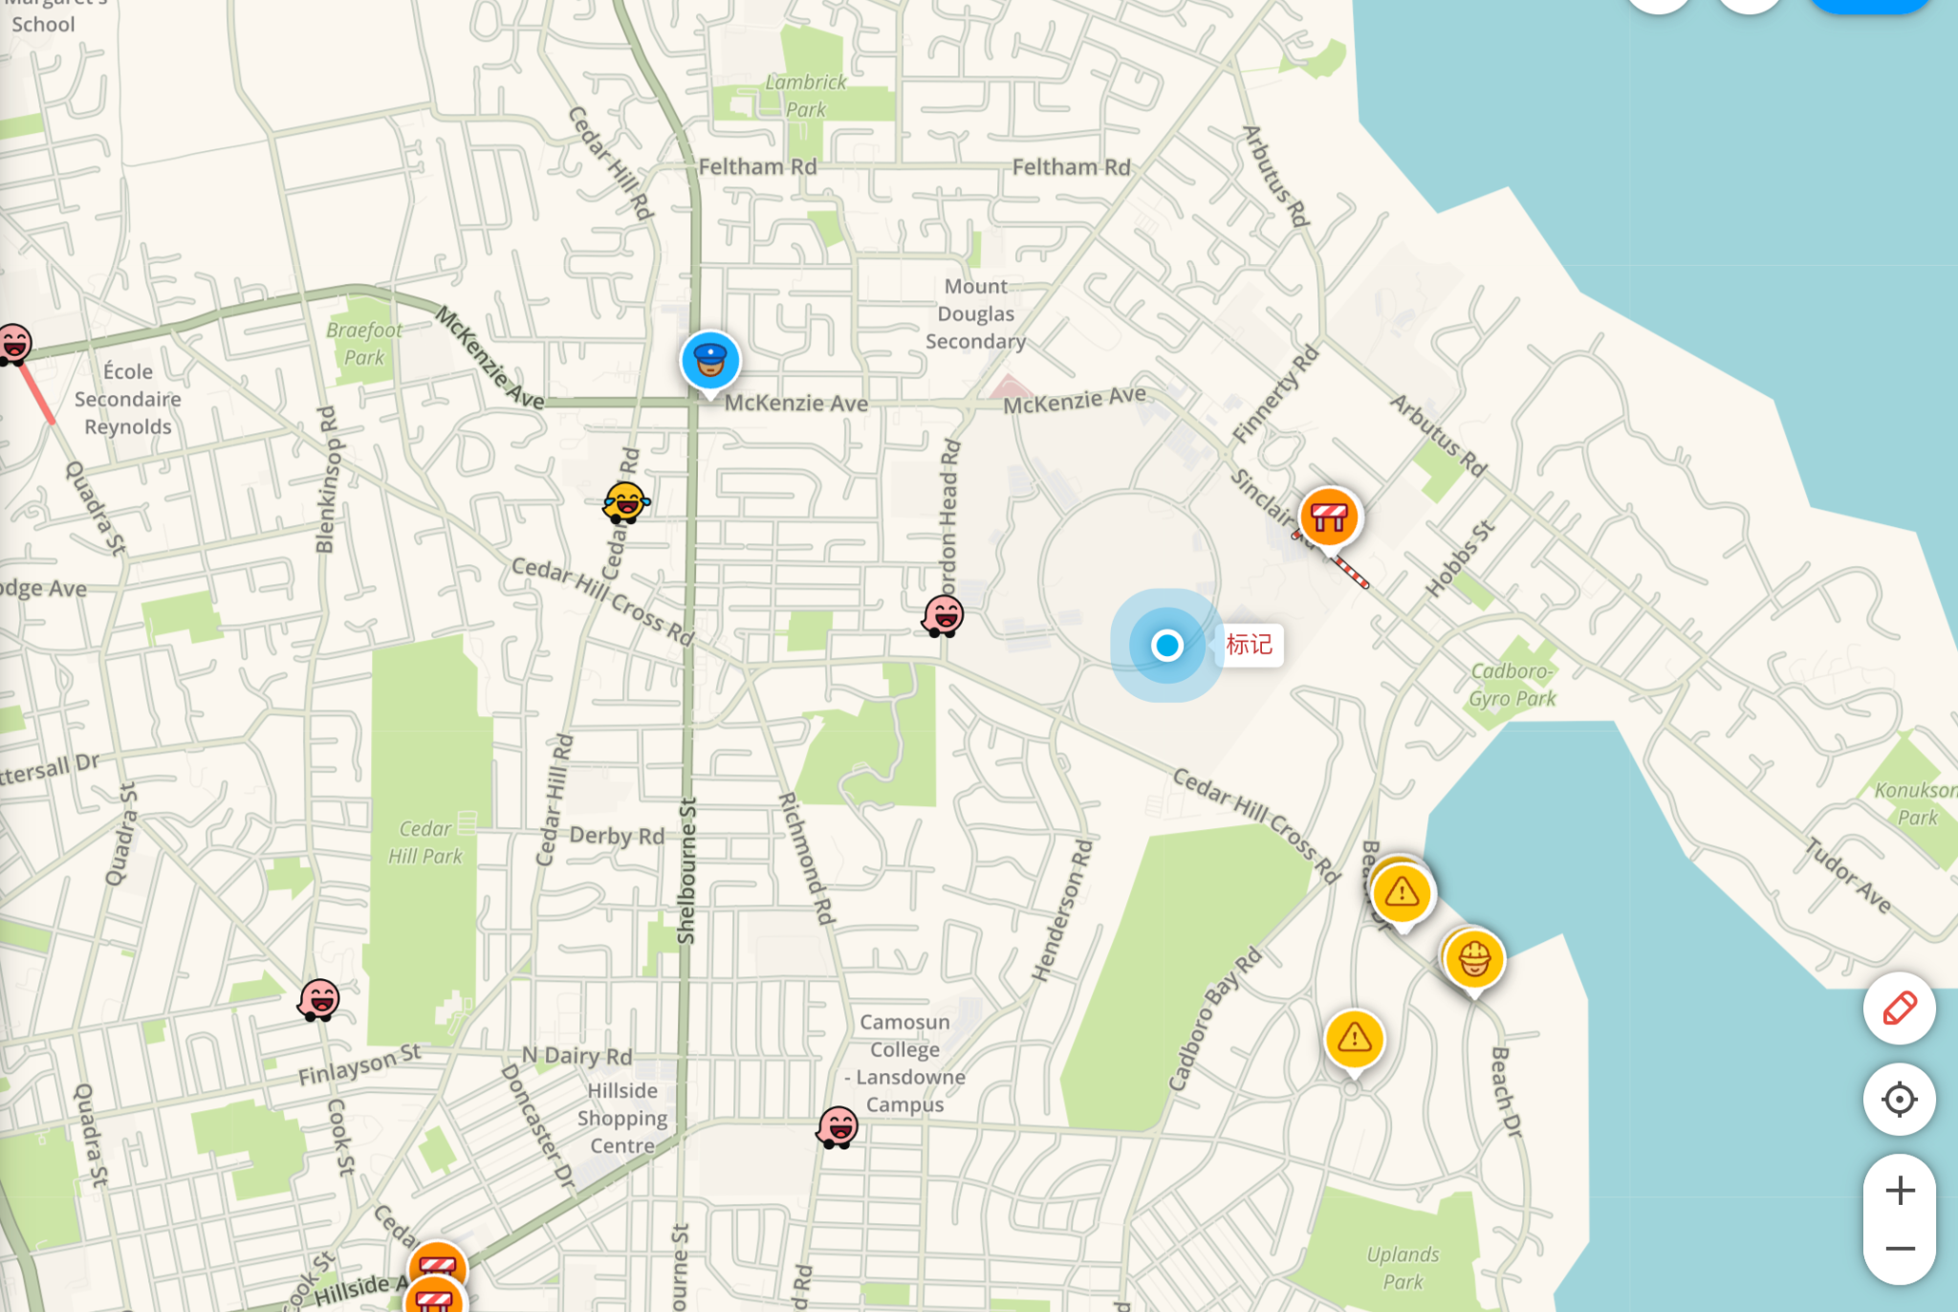
Brief Related Work
What Already Exists?
Google Maps
Waze
No personalized construction alerts
Crowdsourced data—can be unreliable or outdated
Notes:
There are similar existing tools like Google Maps and Waze, but Google Maps doesn’t offer personalized alerts, while Waze relies on crowdsourced data which can be outdated and unreliable. Our solution fills this gap by combining official data with user preference to provide proactive and trustworthy notifications.

Slide 4
Key User Research Findings
Road delays due to construction led to frustration
Construction delays can affect those that don’t drive (buses, rideshare)
Users often found construction information was often too general
Tough getting informations through multiple municipalities
Not personalized to their individual commutes
Users wanted a intuitive way to get the information easily
Notes:
Here are some of the findings we got from our research, we found out that on top of the drivers, those who travel by rideshare and buses are also affected. People also thought that the construction info online are often too general and are hard to find, they wanted to get info that are related to their own situations more easily. Based on these, we built our prototypes.

Slide 5
Prototype Evolution
Low Fidelity: Paper Prototype
Created a mock website
Very limited functionality
Created the foundation of what our website aimed to achieve
Helped us improve on the design
Notes:
Our First Prototype (Website created on paper)
Created a Mock Website: It was essentially combining all of our ideas during the brainstorming phase into one unique idea
Created the Foundation && Helped Improve on the design: We created the core pages of our website and a minimal work flow where somebody using our prototype could sign up and fill in their information and get a be alerted to construction on their route

Slide 6
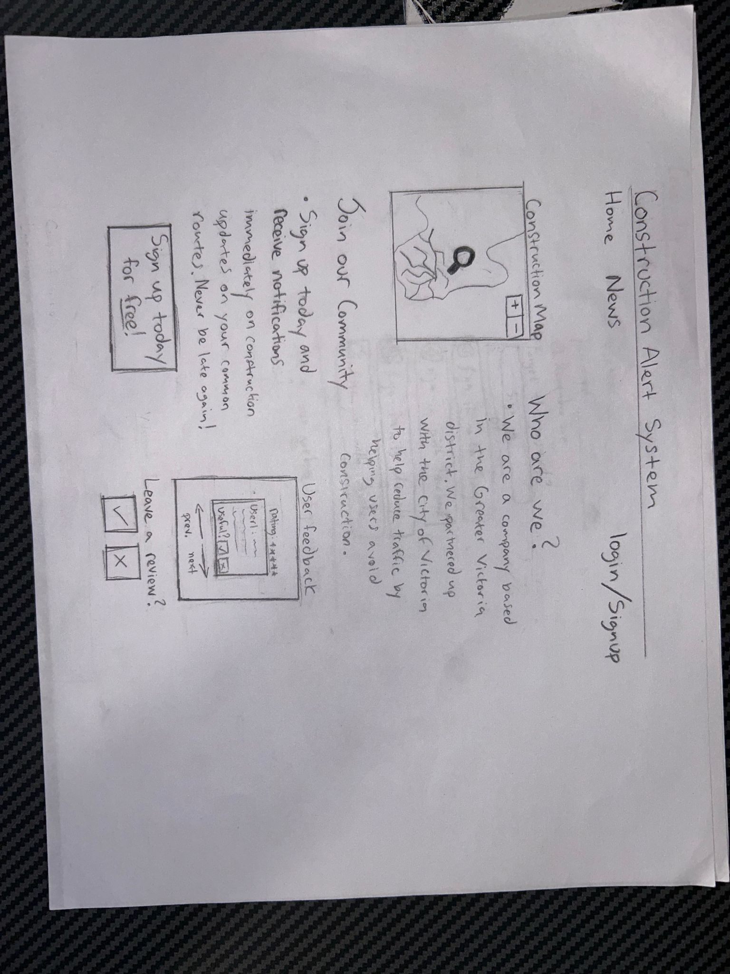
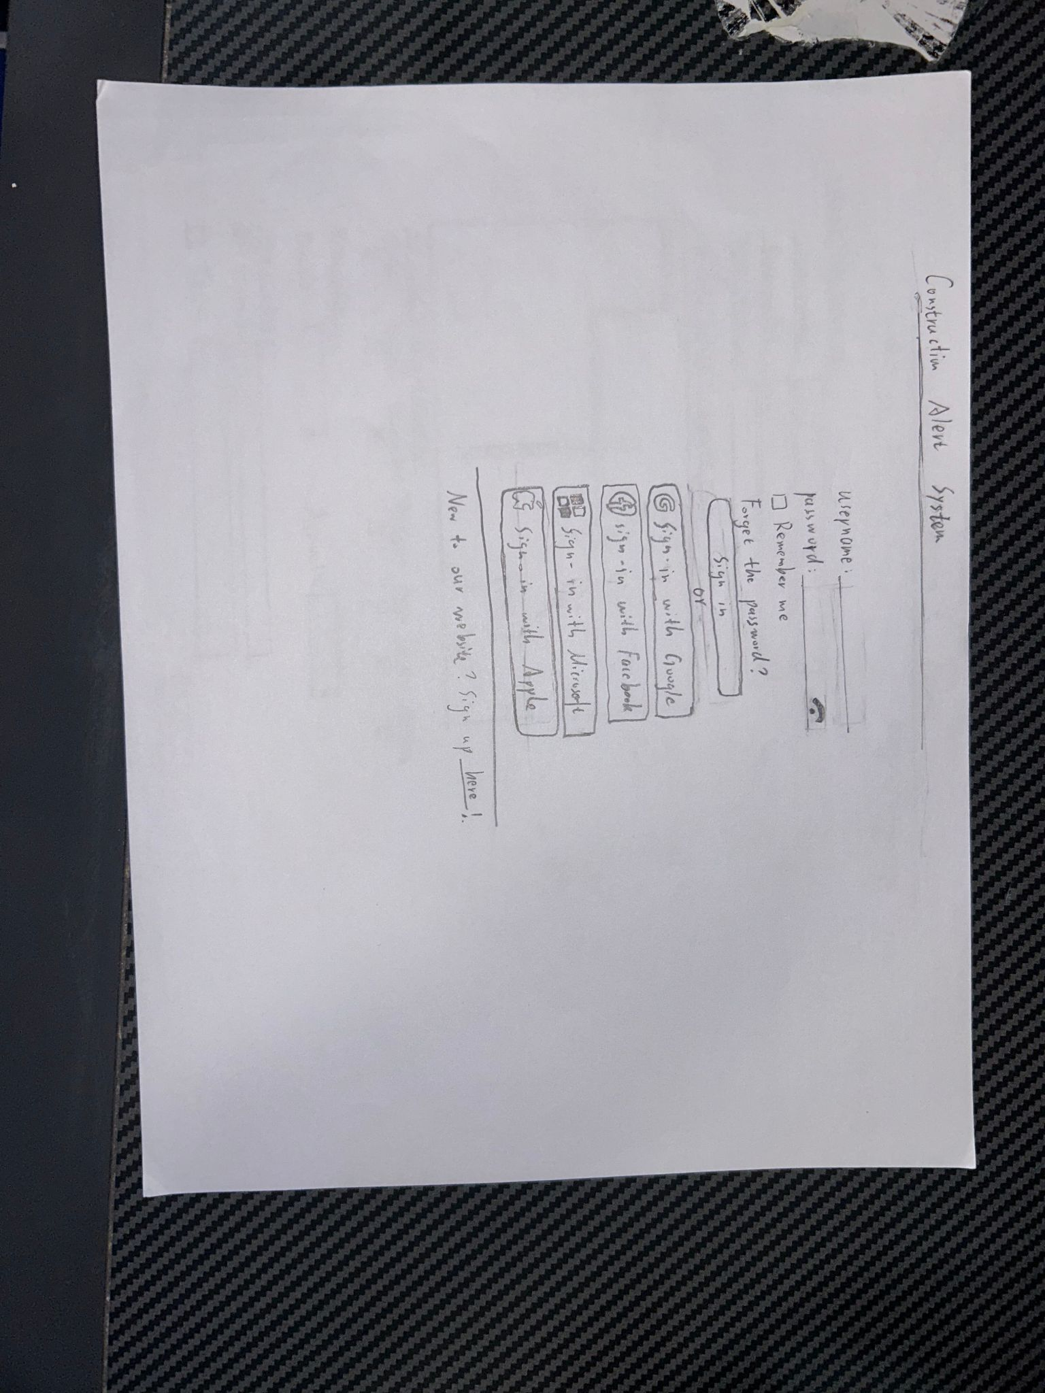
Low Fidelity Prototype
Landing Page
2. User Signup/Login Page
Notes:
Landing Page
We wanted to entice users to signup
Wanted our website to show (not tell) why our prototype was useful (included construction map for this reason)
Login / Signup page
This is where you are taken if you are wanting to sign up or login, you can login with other services
If you do not have an account you can sign up for one

Slide 7
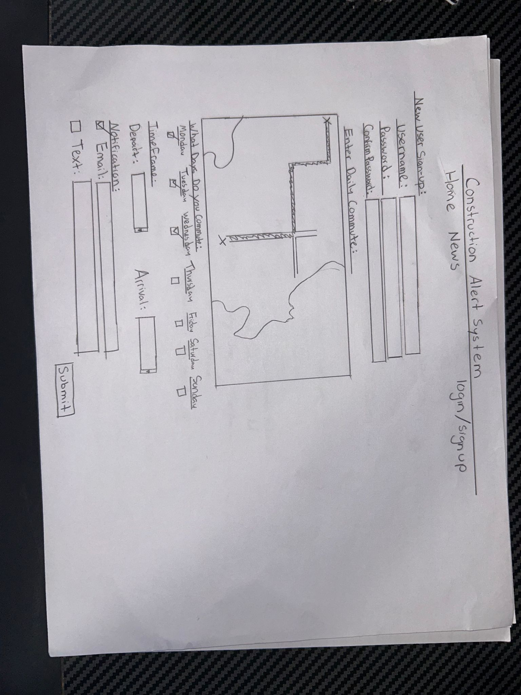
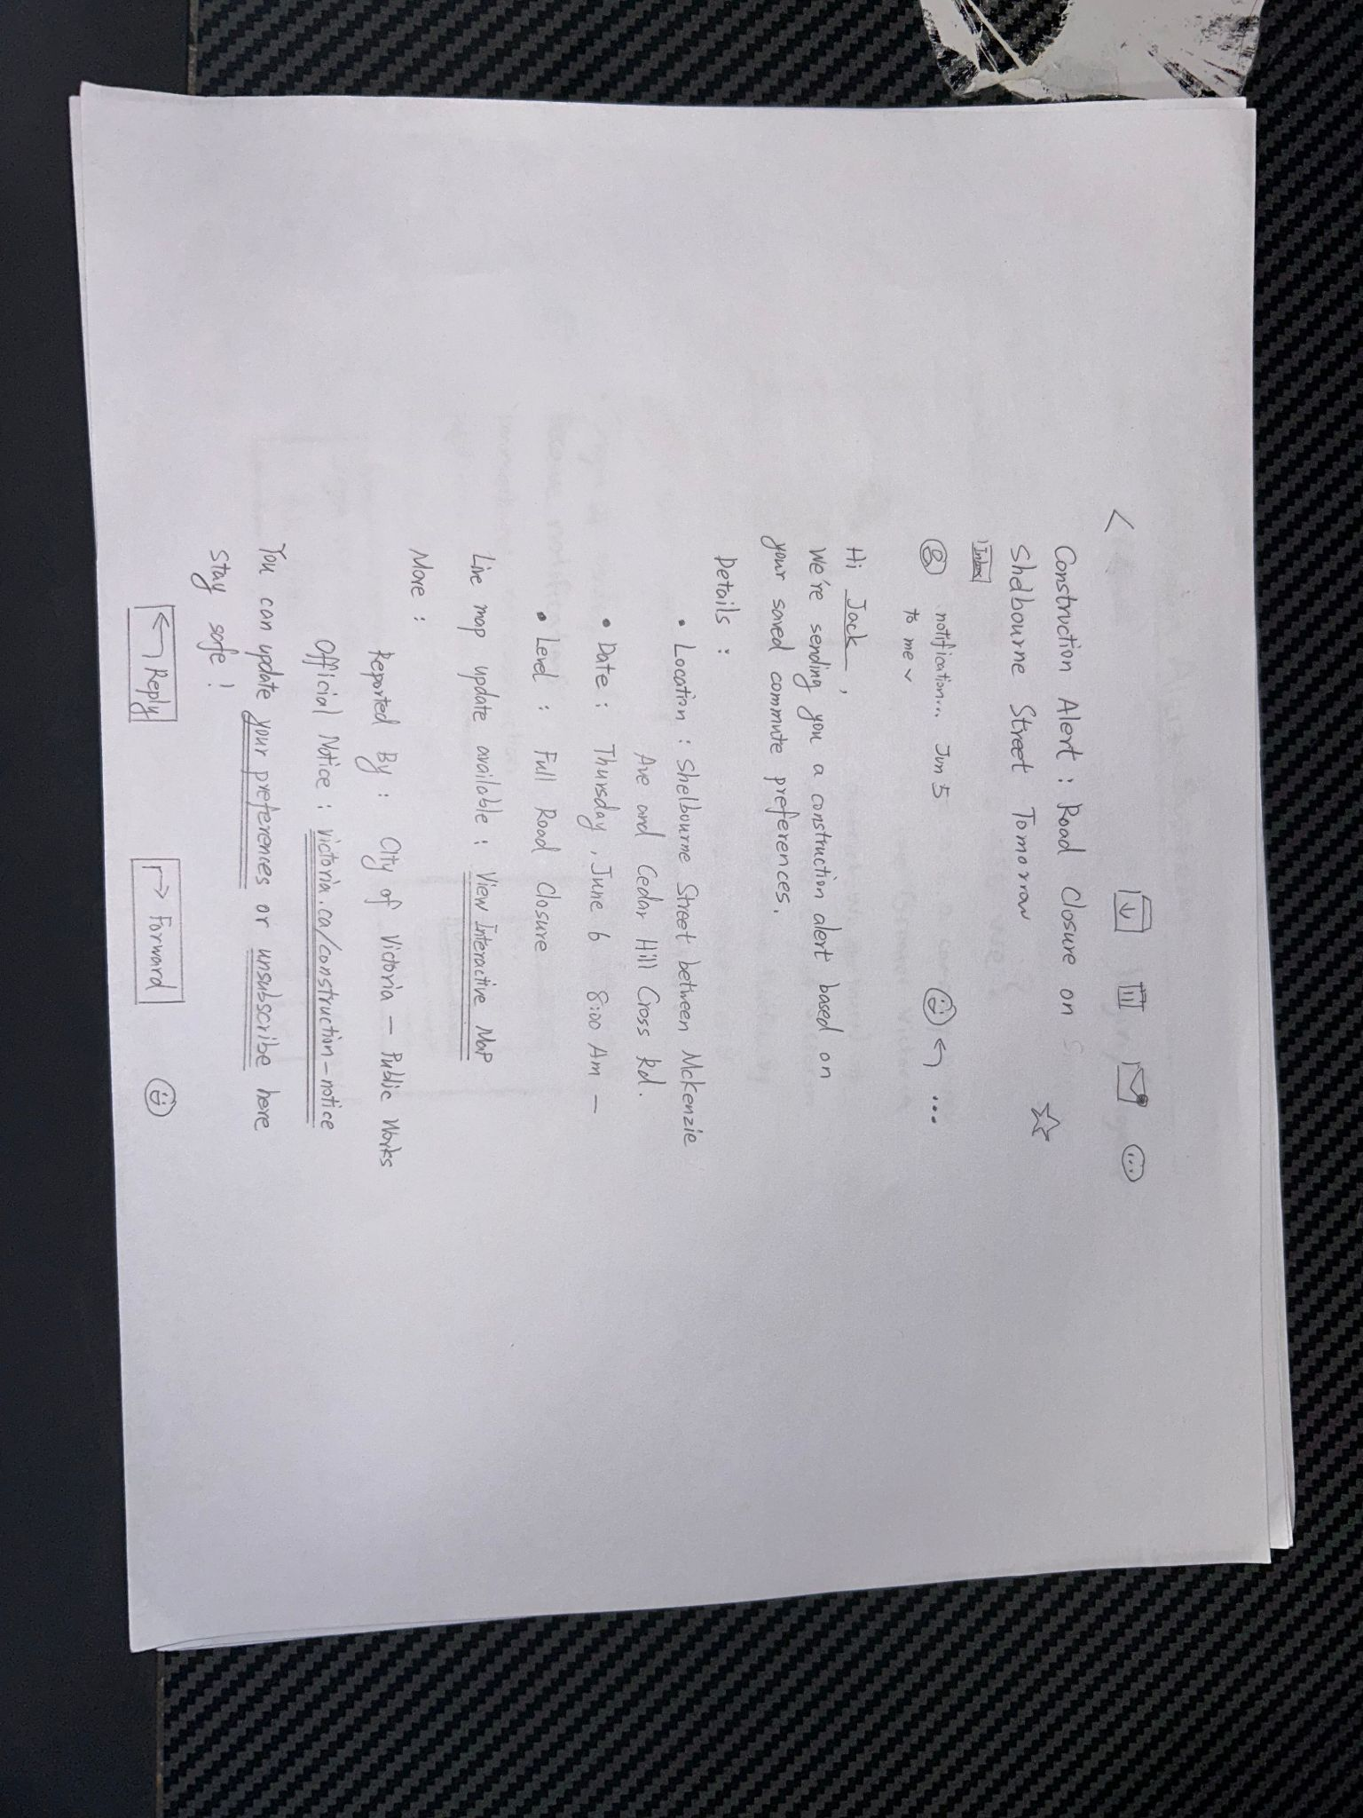
Low Fidelity Prototype
3. User Enters Details
4. Email Notification
Notes:
3. Enter User Details
Taken here immediately if you are signing up for the first time
Fill in your information such as specifics for your daily commute (what time, where, when)
4. Email Notification
This would be the notification you receive and it provides information on road construction along your commute

Slide 8
Prototype Evolution
Slides Prototype Evolution
Currently much more dynamic than previous iterations
Accurate representation of a website
Has clickable links now and checkboxes and features of a website
Took advice from pilot session and final study to create better functionality
Ex) In the pilot study we realized that the Login/Signup feature in the navigation bar is hard to see.
Notes:
Medium Fidelity - We created a slides presentation that was pretty resemblant of actually being on a website (users could click through the slides and actually interact) – encapsulates the user experience
we had to make the website more navigational free so users could essentially go wherever they want onto the website with clickable links and back buttons
We improved upon the design in certain areas given feedback and also some reflection on the previous prototype

Slide 9
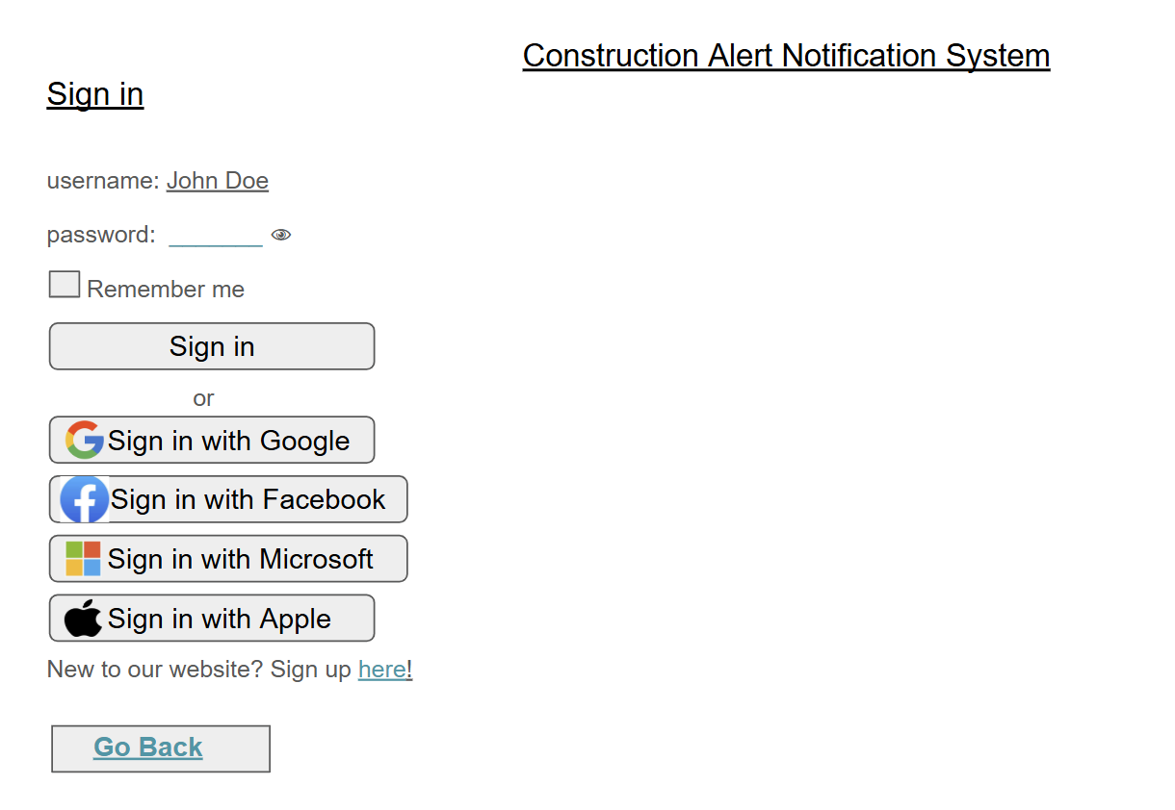
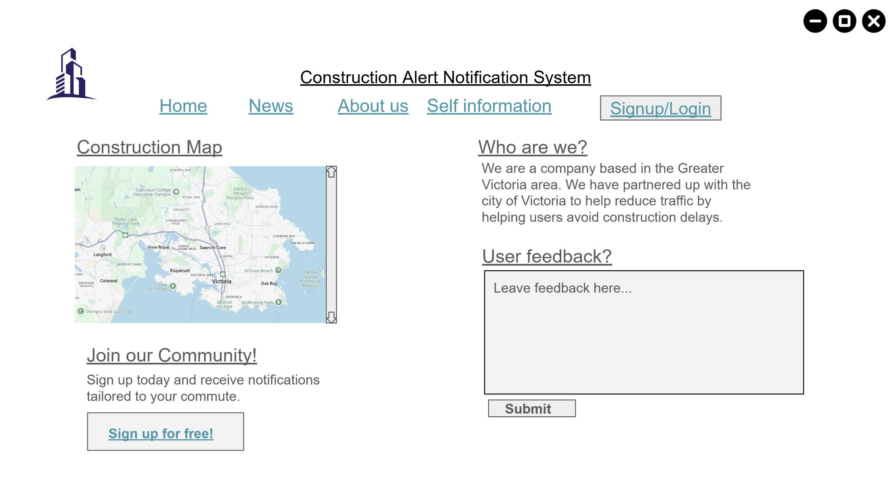
Medium Fidelity Prototype
dfdf
1. Main page of CANS website
2. Login or sign up for an account
Notes:
Main page
As you can see the general structure of the prototype is similar to the previous ones with some minor improvements such as condensing some paragraphs on our landing page to not be so overly verbose.
Changed the user signup button to be more clear and easier to find.
Login signup page
There is a back button here for the users to go back if they change their mind so they are more free to navigate the website on their own terms.

Slide 10
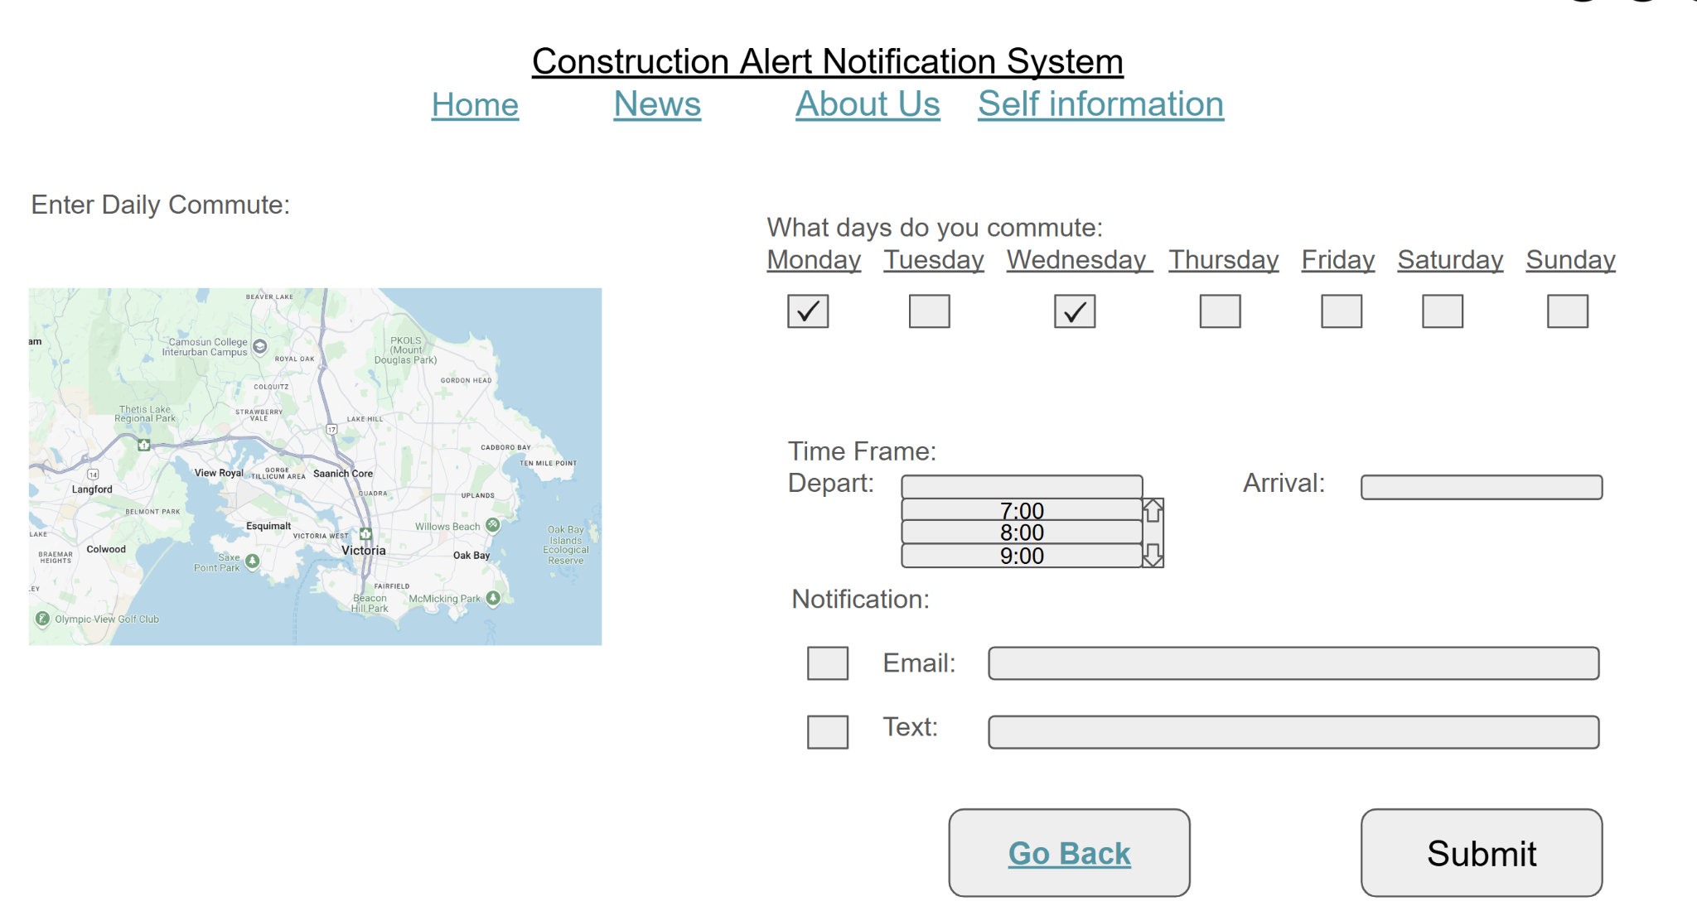
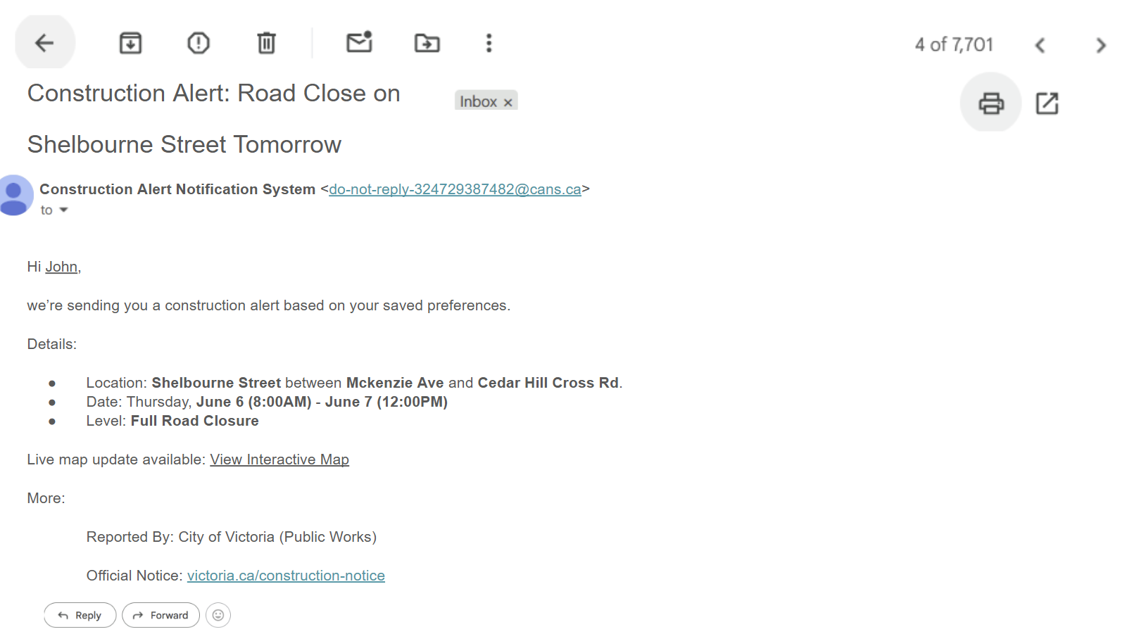
Medium Fidelity Prototype cont..
3. Enter details once account created or logged in
3. Enter details once account created or logged in
4. Receive alerts via preferred method
Notes:
Enter user information much more clear
Change: Notification was overly verbose
Design intended to be much more concise

Slide 11
Key Final User Evaluation Results
Quantitative results:
All participants successfully completed the key tasks within reasonable amount of time/clicks and reported that the process was generally intuitive.
Participant | Time to Complete | Number of Clicks
1 | 2 minutes 10 seconds | 35
2 | 1 minute 23 seconds | 29
3 | 1 minute 30 seconds | 36
4 | 1 minute 16 seconds | 28
Pilot | 1 minute 30 seconds | 26
Average: | 1 minute 34 seconds | 31
Notes:
For our final user evaluation – we got users to complete two tasks using our evolved prototype:
a) sign up for a account
b) create a personalized construction alert
After user evaluations were completed quantitative results showed an average completion time of 1 minute 34 second to complete both tasks.
An average of 31 clicks were made to also complete the task which required a minimum of about 24 clicks

Slide 12
Key Final User Evaluation Results
Qualitative results:
Organizing Themes | Basic Themes (codes)
Opinions on the aesthetic and visual design of the website. | Simple design, good logo
 | Clean design, clearly free
 | Easy to navigate
Issues and feedback about the sign up and account management process | No progress status, multiple sign up buttons
 | Unclear link, Confusion around process
 | lack of customization options
Features that users want to be added | Mobile version, more options
 | Maps integration, always up-to-date
 | Sign up instructions, progress bar
Notes:
Qualitative results from our final user study yielded a few key themes.
These codes were primarily obtained from a questionnaire that we provided participants with.
The three largest themes included:
Users liked the clean and simple aesthetic design of the website.
Confusion around the process of creating a personalized construction alert
Features that users would like to see in future iterations.

Slide 13
Lessons Learned
what did you learn new?
We learned the importance of user feedback in usability issues that aren’t obvious during design.
What was surprising?
A small design change can drastically impact user understanding.
What worked well?
Our simple and clear task flow make it easy for users to complete their goals.
What would you improve if you had more time?
We will add more features and beautify the interface
Notes:
About what we learned, One key thing is how valuable user feedback is — it helped us uncover usability issues we didn’t notice during design. We were surprised to see a small design change can drastically impact user. The thing worked well was our clear and simple task flow, which made it easy for users to reach their goals. If we had more time, We will add more features and beautify the interface.

Slide 14
Future Work
The About Us and News sections remain under development.
We lack a real-time integration system, which make a challenge for the system timely updates.
Our system also does not yet include GPS, which limits its ability to provide real-time location-based alerts.
We plan to allow users to contribute construction information.
Notes:
For future work, we’re still developing the About Us and News sections. Right now, the system doesn’t support real-time updates, and we don’t have GPS yet — which means we can’t provide location-based alerts. And we also plan to let users contribute construction information in the future.

Slide 15
Conclusion
Our project shows that even a simple alert system can make commuting more predictable and less frustrating.
By focusing on user needs and using real construction data, We closely link government information with citizen transportation, and use alert system to help people plan better.
This idea could easily be expanded to other cities or used as a model for future public information systems.
Notes:
At last, for conclusion. Our project shows that even a simple alert system can make commuting smoother. By focusing on user needs and real construction data, we connect government information with daily transportation and help people plan ahead. This idea could easily be expanded to other cities or used as a model for future systems.

Slide 16
Thank you for your attention!
Any questions?

